Slide 1
Introduction to Data Analytics Spring 2023
Lecture 2

Slide 2
Today’s topics
Basics of Programming
Control Structures
Conditionals (if/else)
Loops
Functions
Working with files

Slide 3
Basics of Programming (Quiz)

Slide 4
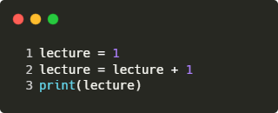

Basics - Variables
Can be named whatever you want
Contain a value that can be overwritten

Slide 5
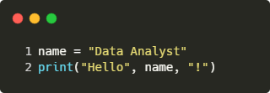

Basics - Print()
Prints strings, variables, etc. on the screen.
You can pass multiple variables with comma separation.

Slide 6
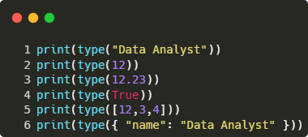
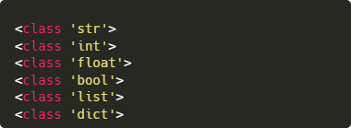
Basics - Data Types
Tells us, what type a value is
int and float can be used for mathematical operations
str is text
bool is useful for decision making
list and dict contain multiple values

Slide 7
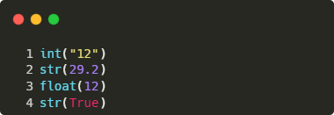
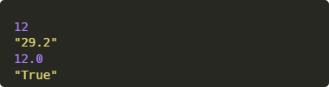
Basics - Type conversion
Some types can be converted into other types
Since mathematical operations can only be performed on numbers, you may need to convert a string containing a number into an actual number (int/float)

Slide 8
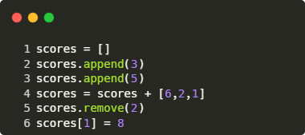

Basics - Lists
Lists are containers with multiple values
You can identify lists by square brackets
Elements can be added, removed, and replaced
More functions exist such as sort, reverse, clear, count, etc.
Elements can be accessed by the index.

Slide 9
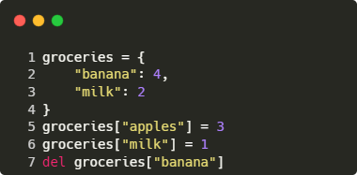
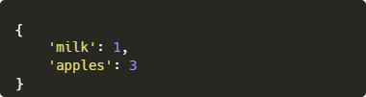
Basics - Dictionaries
Dictionaries are containers with key/value pairs
The keys are strings
The values can be anything. Even another dictionary!
You can identify dictionaries by their curly braces
Elements can be added, removed, and replaced
Elements can be accessed by the key.

Slide 10
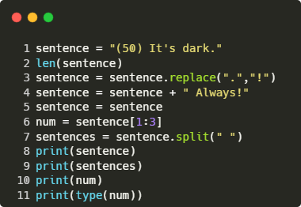
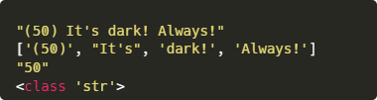
Basics - Strings
Strings are a sequence of characters, marked inside two quotes.
Strings can be analyzed, manipulated, split, combined, etc.

Slide 11
Control Structures: Conditionals (if/else)

Slide 12



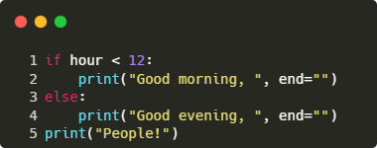
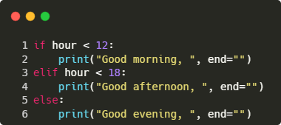
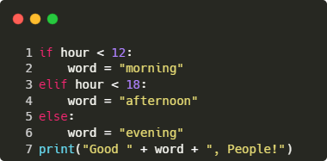
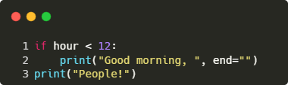
Control structures: Conditionals (if/else)
Depending on a condition, you can execute different code.
The condition has to result in a bool.

Slide 13

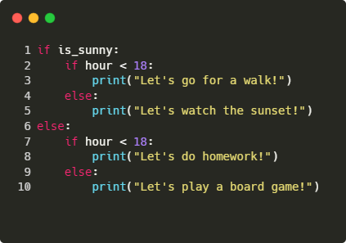
Control structures: Nested Conditionals (if/else)
Depending on a condition, you can execute different code.
The condition has to result in a bool.
The condition can be a bool variable or a comparison.
Conditions can be nested.

Slide 14
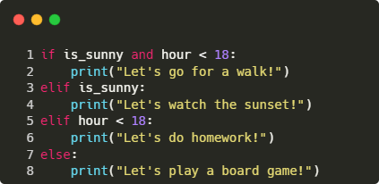
Control structures: Combined Conditionals (if/else)
Depending on a condition, you can execute different code.
The condition has to result in a bool.
The condition can be a bool variable or a comparison.
Conditions can be nested.
Conditions can be combined.

Slide 15
Control Structures: Loops

Slide 16
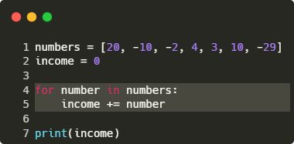

Control structures: Loops
Loops allow you to run the same code for a sequence (list).
A for loop executes the inside of the for loop for every element in a sequence (list).
It creates a temporary variable that is named by you.

Slide 17
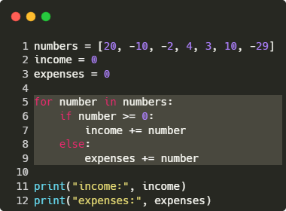

Control structures: Loops
Loops allow you to run the same code for a sequence (list).
A for loop executes the inside of the for loop for every element in a sequence (list).
It creates a temporary variable that is named by you.
For loops are often combined with if/else, but the code can be anything; even another for loop!

Slide 18
Functions

Slide 19
Functions: Concept
a
b
Functions are a predefined block of code.
A function has a name, input parameters, and an optionally an output parameter.
function(a,b)
output

Slide 20
Functions: Concept
“da”
“ta”
Functions are a predefined block of code.
A function has a name, input parameters, and an optionally an output parameter.
combine(a,b)
“data”

Slide 21
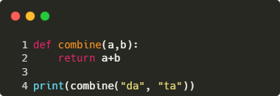

Functions: Example
Functions are a predefined block of code.
A function has a name, input parameters, and an optionally an output parameter.

Slide 22
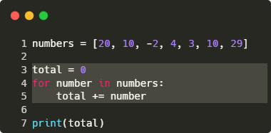
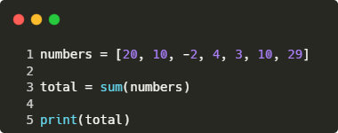
Functions: In-built
Functions are a predefined block of code.
A function has a name, input parameters, and an optionally an output parameter.
Python has in-built functions like sum(), print(), .append(), etc.

Slide 23
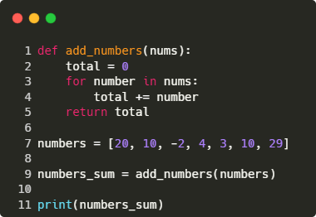
Functions: User-defined
Functions are a predefined block of code.
A function has a name, input parameters, and an optionally an output parameter.
Python has in-built functions like sum(), print(), .append(), etc.
You can write your own functions.

Slide 24
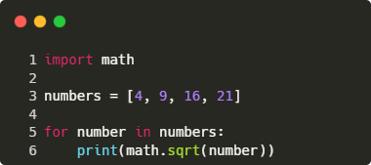
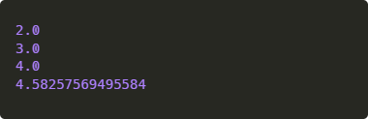
Functions: Libraries
Functions are a predefined block of code.
A function has a name, input parameters, and an optionally an output parameter.
Python has in-built functions like sum(), print(), .append(), etc.
You can write your own functions.
Libraries are collections of functions which contain more functions.

Slide 25
Working with files

Slide 26
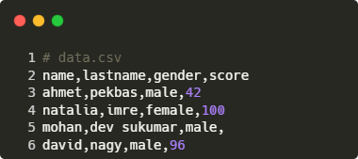
Working with Files
We will work with data files.
.csv and .json files are used to store data, but other file types exist.

Slide 27
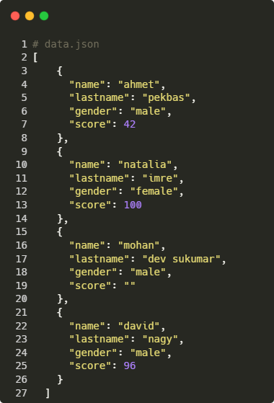
Working with Files
We will work with data files.
.csv and .json files are used to store data, but other file types exist.

Slide 28
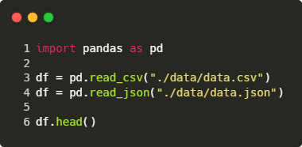
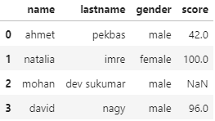
Working with Files
We will work with data files.
.csv and .json files are used to store data, but other file types exist.
Pandas is a library to load, view, and edit these files.

Slide 29
Break - Then it’s your turn!

